Slide 1

Fit Pulse – Anomaly Detection from Wearable Devices
Module 1: Data Collection & Preprocessing
Data Collection & Preprocessing focuses on collecting raw wearable sensor data and converting it into a clean, structured dataset suitable for machine learning and anomaly detection.

Slide 2

Introduction
Wearable health devices continuously capture physiological parameters:
Heart rate
Step count
Sleep stages
Activity patterns
But raw sensor data usually contains:
Missing timestamps
Irregular sampling
Outliers
Sensor noise
Inconsistent formatting

Slide 3
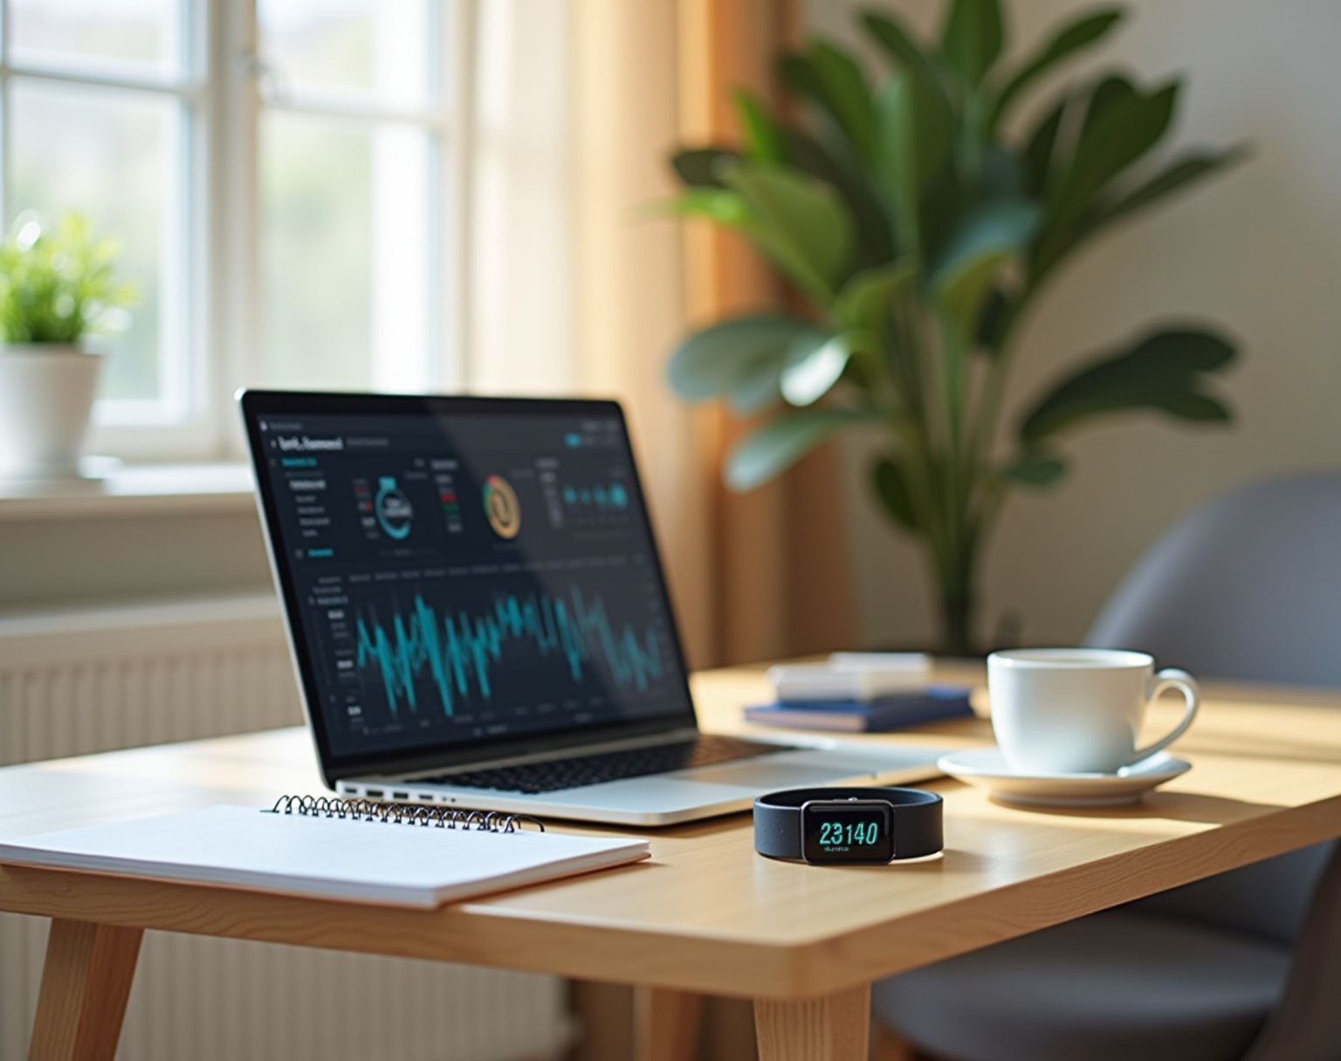
Objective
Load raw CSV/JSON files
Standardize column names
Parse timestamps & convert to UTC
Handle missing values
Detect & flag outliers
Resample data into fixed time intervals
Check time-series consistency
Export cleaned datasets

Slide 4
Workflow Overview
Step | Operation
1 | Load raw sensor data
2 | Convert timestamps to UTC
3 | Impute missing data
4 | Remove/flag invalid entries
5 | Outlier detection (IQR)
6 | Resample to uniform time interval
7 | Standardize columns
8 | Export cleaned data

Slide 5
Sample Raw Data
timestamp | hr_bpm | steps_count | sleep_state | mins
2025-11-01 06:01 | 72 | — | — | —
2025-11-01 06:05 | 188 | 7 | — | —
2025-11-02 23:15 | — | — | deep | 45

Slide 6
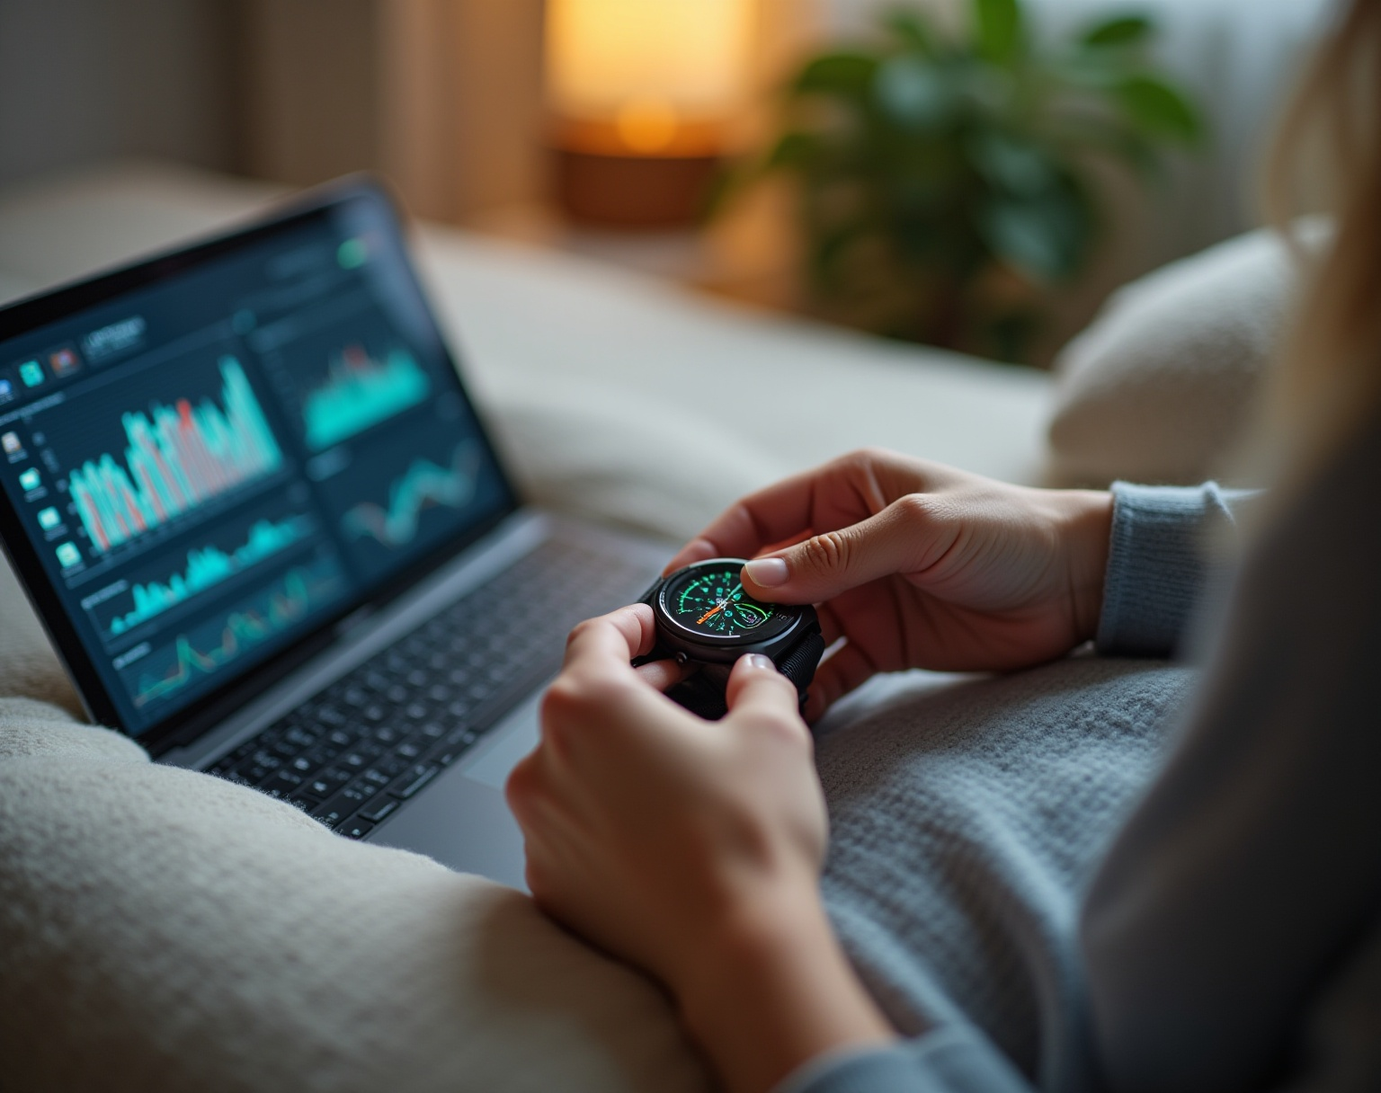
Preprocessing Steps
Missing value handling
HR → forward-fill + interpolation
Steps → missing = 0
Sleep duration → median fill
Sleep stage → forward/back fill
✔ Timestamp correction
Convert to valid datetime format
Normalize to UTC
✔ Outlier detection
IQR-based anomaly flagging
✔ Final output
Fully cleaned dataset with uniform timestamps.

Slide 7
Cleaned Data
timestamp | hr_bpm | steps_count | sleep_state | mins
2025-11-01 06:01 | 72 | — | — | —
2025-11-01 06:05 | 188 | 7 | — | —
2025-11-02 23:15 | — | — | deep | 45

Slide 8
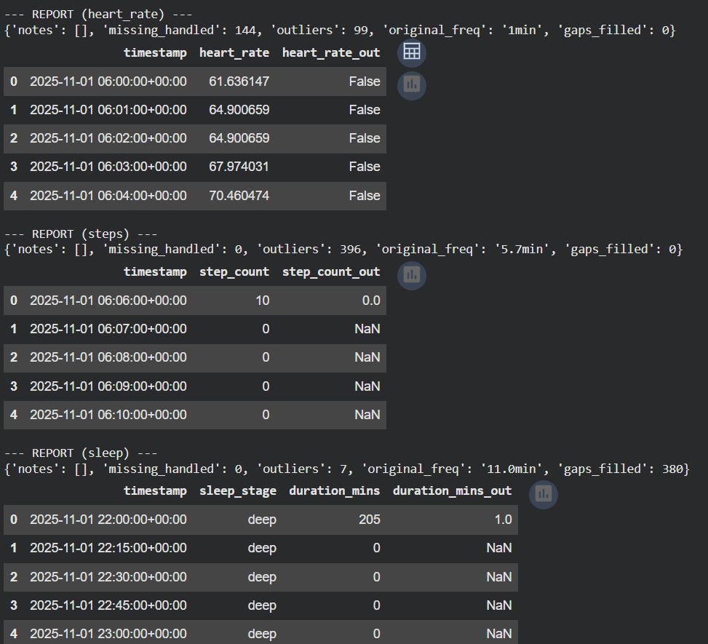
Preprocessing Output Summary
Generated Outputs Include:
✔ Processed heart rate (1-min interval) ✔ Processed steps (1-min interval) ✔ Processed sleep (15-min interval) ✔ Full preprocessing report JSON ✔ Outlier flags

Slide 9
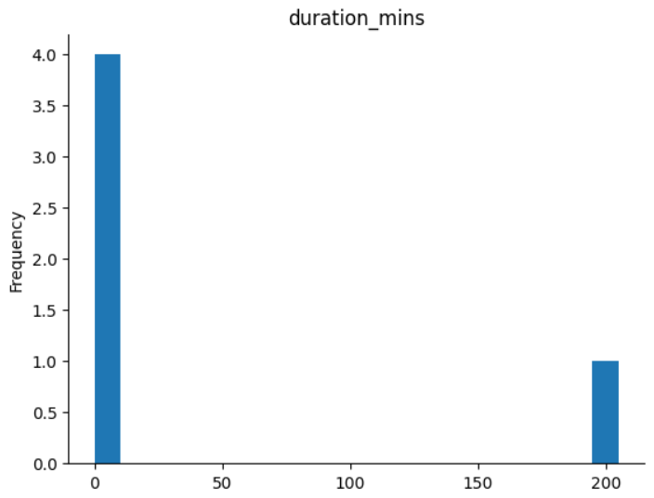
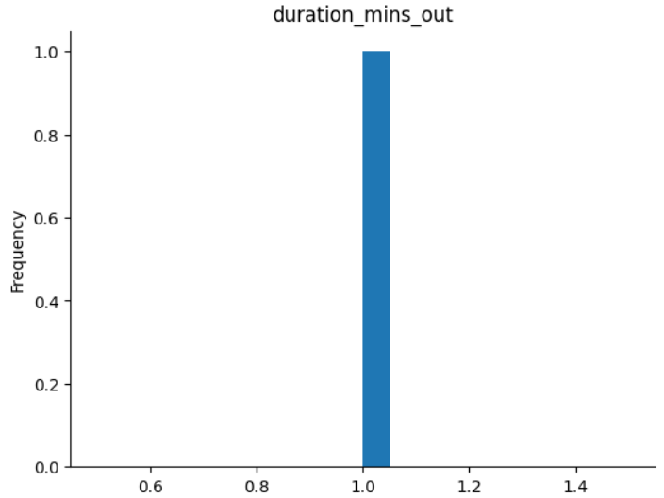
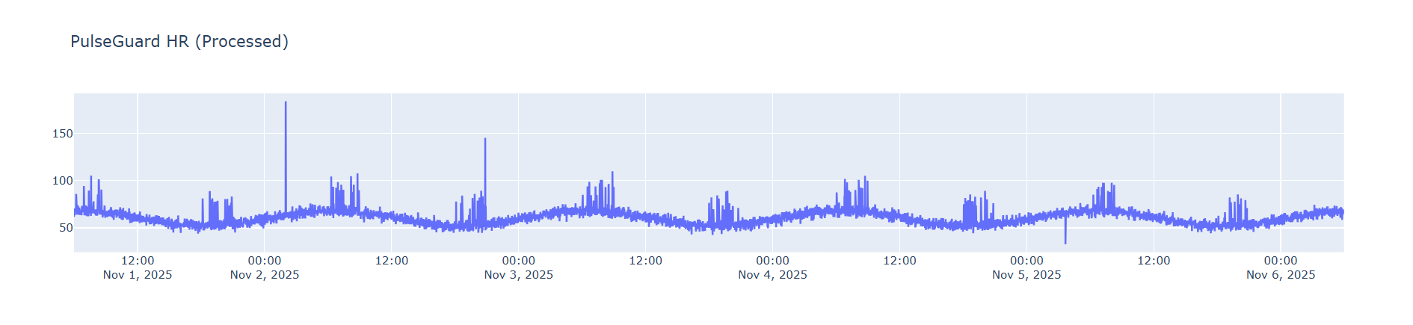

Slide 10
Conclusion
In this module, the raw wearable data collected from fitness devices was transformed into a clean, reliable, and analysis-ready format. Through systematic preprocessing steps—such as timestamp correction, missing value handling, outlier detection, and time-series resampling—the heart rate, steps, and sleep datasets were standardized and aligned to a consistent timeline. This ensures that the data is stable, uniform, and suitable for further analysis.
With Module 1 completed successfully, the processed outputs now form a strong foundation for the next stages of the project, including feature extraction, modeling, and anomaly detection. Overall, preprocessing has significantly improved data quality, making future insights more accurate and meaningful.

